Slide 1
ROCKBUSTER STEALTH Launch Strategy for the New Online Service
Emine Seyda Tatlicioglu
June 2022

Slide 2
Introduction
Rockbuster Stealth LLC is a movie rental company that had stores all around the world. Because of the stiff competition from streaming services the management team is planning to use our existing movie licenses to launch an online video rental service to stay competitive. In order to come up with a plan, we need to answer key business strategy questions using insights from the current data we have.
Objective:
Develop insights to help with the launch strategy for the new online service.
Tools:
SQL - to retrieve data from RDMS and analyze the data
Excel – to analyze and organize the data
Tableau – to visualize the data to have insights

Slide 3
Business Strategy Questions
Current Situation
- What was the average rental duration for all videos?
Product
– Which movies, genres and ratings have the most revenue gain?
Customers
- Where are customers with a high lifetime value based?
Market
– Which countries are Rockbuster customers based in?
Sales
– Do sales vary between geographic regions?

Slide 4

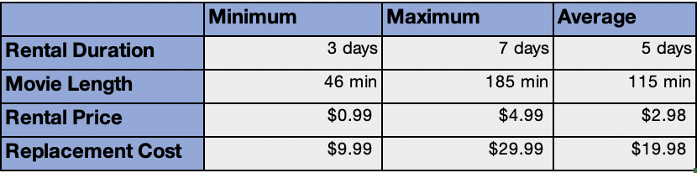
Current Situation What was the average rental duration for all videos?

Slide 5
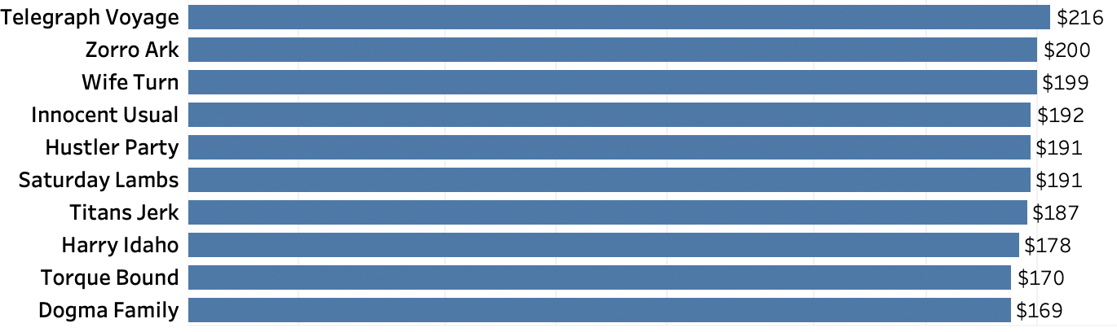
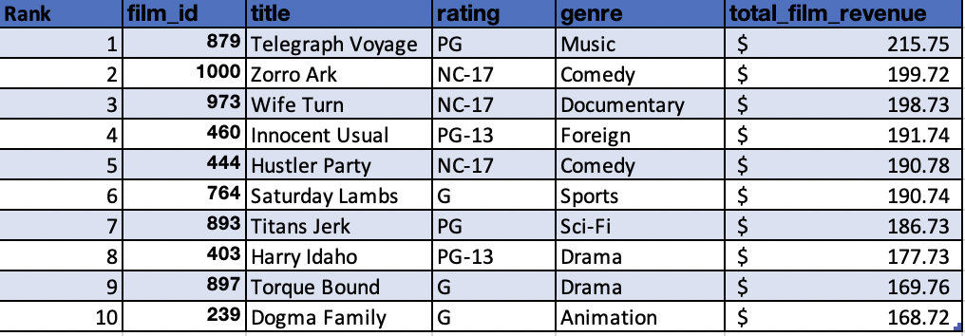
Product Which movies, genres and ratings have the most revenue gain?
Top 10 revenue generating movies
Key statistics for 10 revenue generating movies

Slide 6
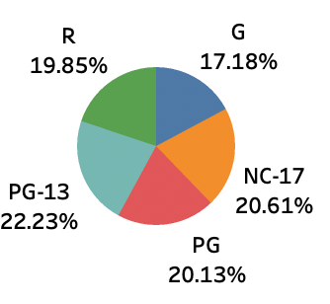
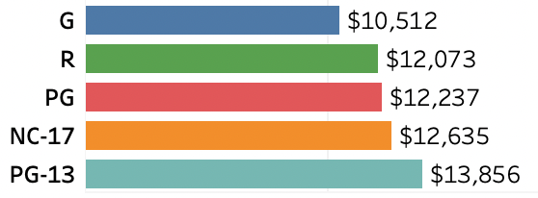
Product Which movies, genres and ratings have the most revenue gain?
Percentage of movie ratings
in the film market
Revenues by movie ratings

Slide 7
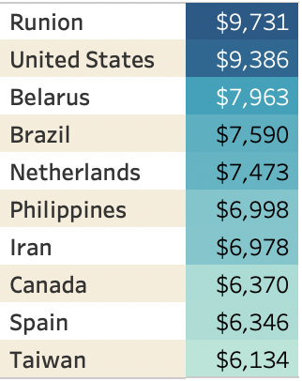
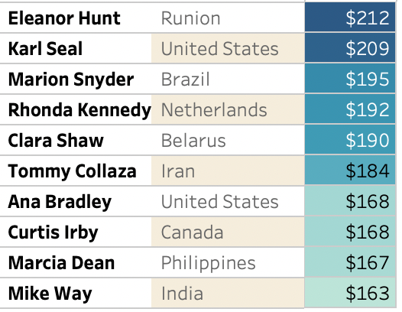
Customers Where are customers with a high lifetime value based?
Top 10 countries
(based on the revenue)
Top 10 customers with a high lifetime value

Slide 8
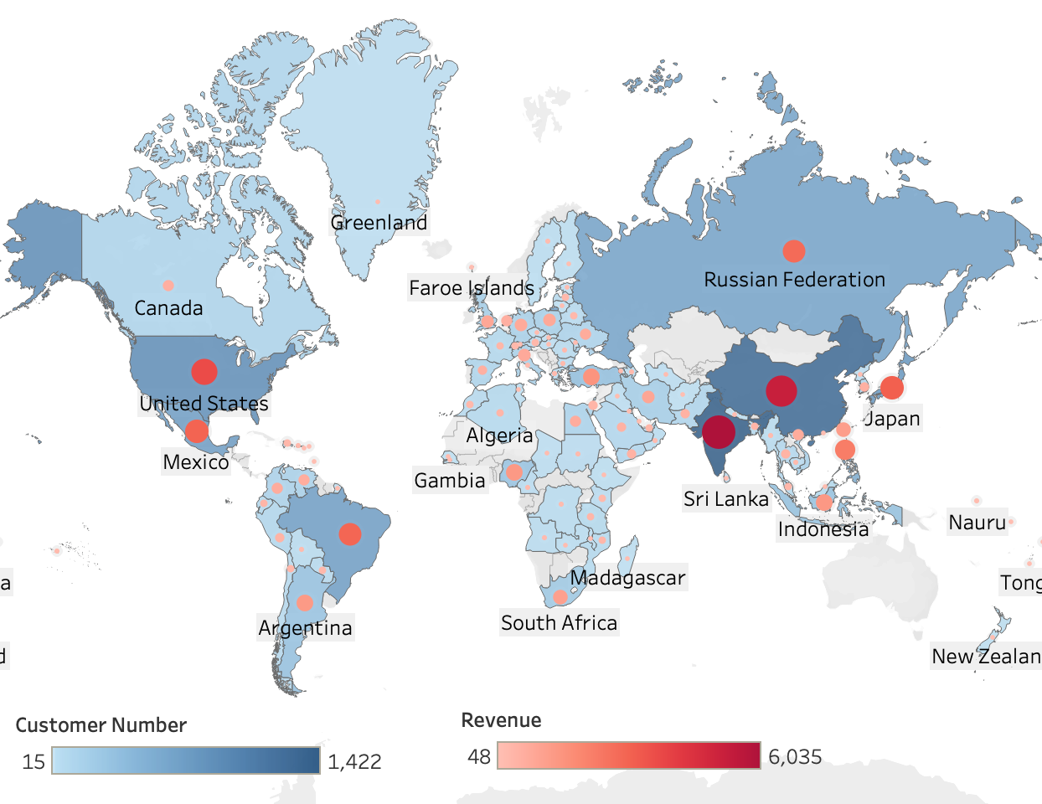
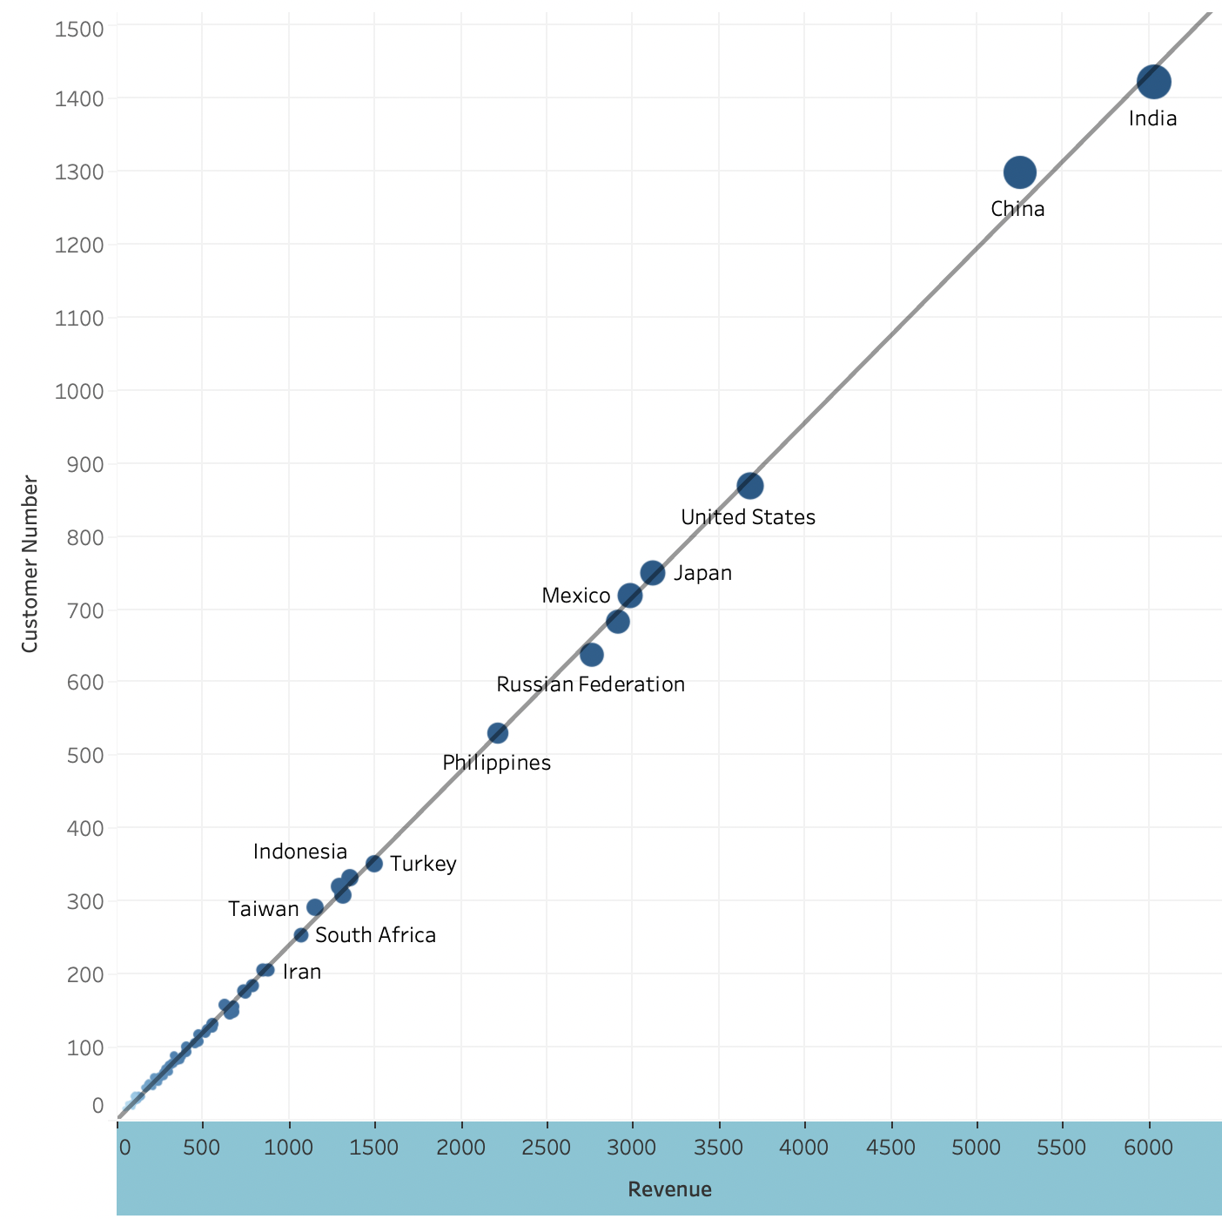
Market Which countries are Rockbuster customers based in?
Geographic customer distribution by revenue
Correlation between customer numbers and revenue

Slide 9
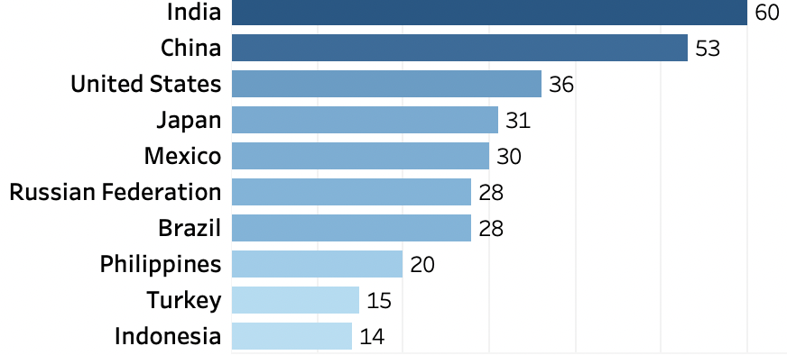
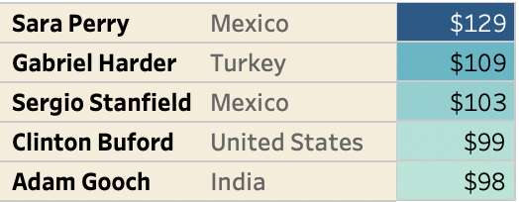
Market Which countries are Rockbuster customers based in?
Top 10 countries by customer numbers
Top 5 customers within top 10 countries
by revenue

Slide 10
Insights and Recommendations
Insights
Average rental duration is 5 days.
PG-13 rated movies and movies in the sport genre contributed the most revenue gains.
Rockbuster’s costumers are located worldwide.
India, China and the United States have the most costumer numbers and the revenue among the other countries.
Recommendations
Because of the international presence of the company, the language of movie spectrum should be expanded to common languages such as Chinese, Spanish and Hindi.
Focus on adding movies to inventory with the most profitable ratings and genres. Especially PG-13 rating and the Sports, Sci-Fi and Animation genres.

Slide 11
THANK YOU
Data dictionary, Queries, and Query Outputs are available upon request.
Link to Tableau Visualizations : Rockbuster Stealth Tableau Link

